Slide 1
UHG - Overview
UnitedHealth Group is a diversified health care company with a mission to help people live healthier lives and help make the health system work better for everyone.
Our two complementary businesses
Optum
UnitedHealthcare
Driven by this unified mission and vision to improve health care access, affordability, experiences and outcomes for the individuals and organizations we are privileged to serve.

Slide 2
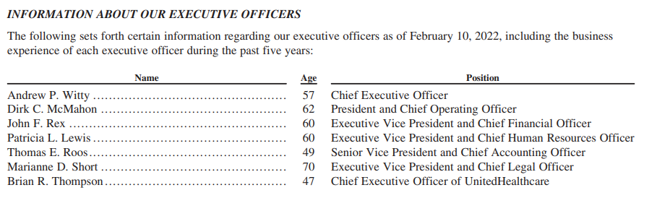
Executive Officers
Cory B. Alexander - Executive Vice President, Corporate Affairs, UnitedHealth Group
Terry M. Clark - Senior Vice President and Chief Marketing Officer, UnitedHealth Group
Richard Mattera - Senior Vice President and Chief Development Officer, UnitedHealth Group
Richard Migliori, M.D. - Executive Vice President, Medical Affairs, and Chief Medical Officer, UnitedHealth Group
Dan Schumacher - Chief Strategy and Growth Officer, UnitedHealth Group
Jennifer Smoter - Senior Vice President and Chief Communications Officer, UnitedHealth Group
https://www.unitedhealthgroup.com/content/dam/UHG/PDF/investors/2021/UNH-Q4-2021-Form-10-K.pdf

Slide 3
UHG : UHC and OPTUM
Fortune 5 Company (500 largest U.S corporation)
Fortune 8 Company (Global 500 – world’s largest)
$ 385.8 BN
~ 350 K Employee across the continents
Founded 1977
UnitedHealthCare
Individual & Employer – 26 MN
Medicare – 13 MN & Medicaid – 6.9 MN
UHC Global – 7.6 MN
Optum
OptumHealth (Care Delivery) – 99 MN
OptumInsight (Analytics & Consulting)
OptumRx – 1.3 BN adjusted scripts

Slide 4
What We Do
Rewarding Quality & Effective Care.
See how OptumLabs and America's Health Rankings are promoting the use of data and insights to improve care and advance evidence-based medicine
Reducing The Total Cost of Care.
Read how we are helping to reduce the total cost of care by applying value-based incentives and optimizing sites of care with Centers of Excellence.
Strengthening The Patient-Physician Relationship.
Learn how we are helping members navigate the health system with Advocate4Me and providing personalized care for families who have children with special needs.
Achieving Better Health.
See how we are strengthening home-based care with HouseCalls and promoting prevention and wellness with Rally®.
Building Healthier Communities.
We combine our knowledge, experience and compassion – as an enterprise and as individuals – to make a meaningful difference in the communities where we live and work.

Slide 5
Mapping
Program | LOB/Domain
A4ME | E&I(UHC)
OFSC | Optum Insight
N4ME | M&R(UHC)
CURO | Optum Insight (Optum)
Dispensing As A Service | Optum RX (Optum)
Facets Upgrade Factory | M&R(UHC Tech)
HEMI | Optum RX (Optum)
Pharmacy Central | Optum RX (UHC)
Appeal Re-design | E&I (UHC)
Claims Auditor | Optum Insight (Optum)
MRCP | M&R(UHC)
USP | E&I (UHC)
Level Funded full Launch | E&I (UHC)
PDP | Provider (UHC)

Slide 6
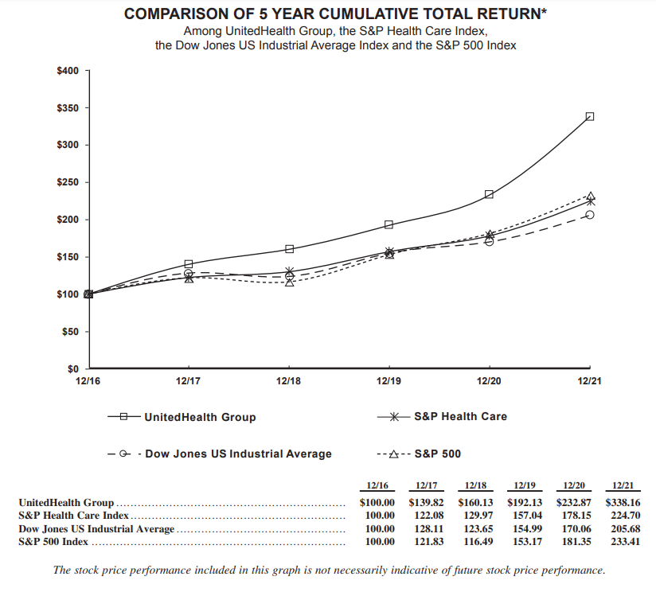
Cumulative Total Return
$ 538 UNH – As of 19th April 2022)

Slide 7
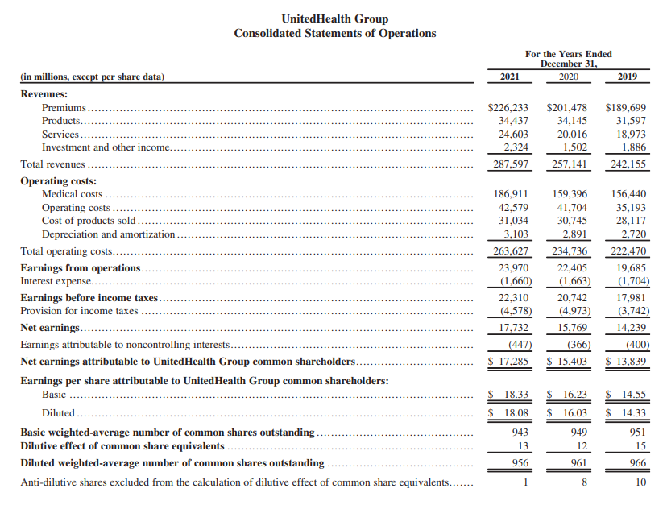
UHG: Consolidated Statements of Operations

Slide 8
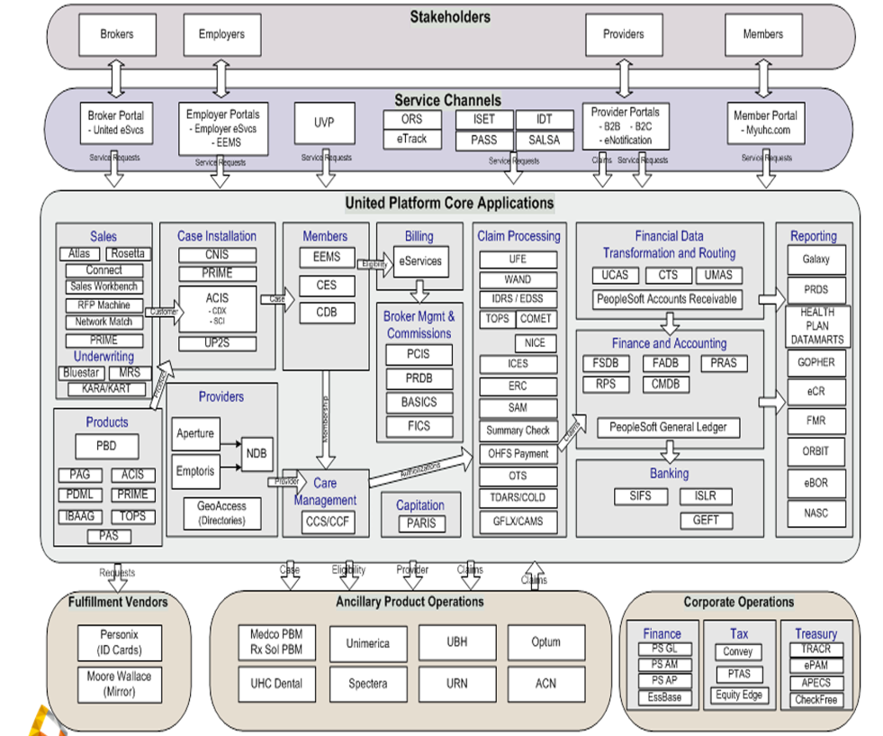
High level – UHG Application Landscape (Old)

